Slide 1
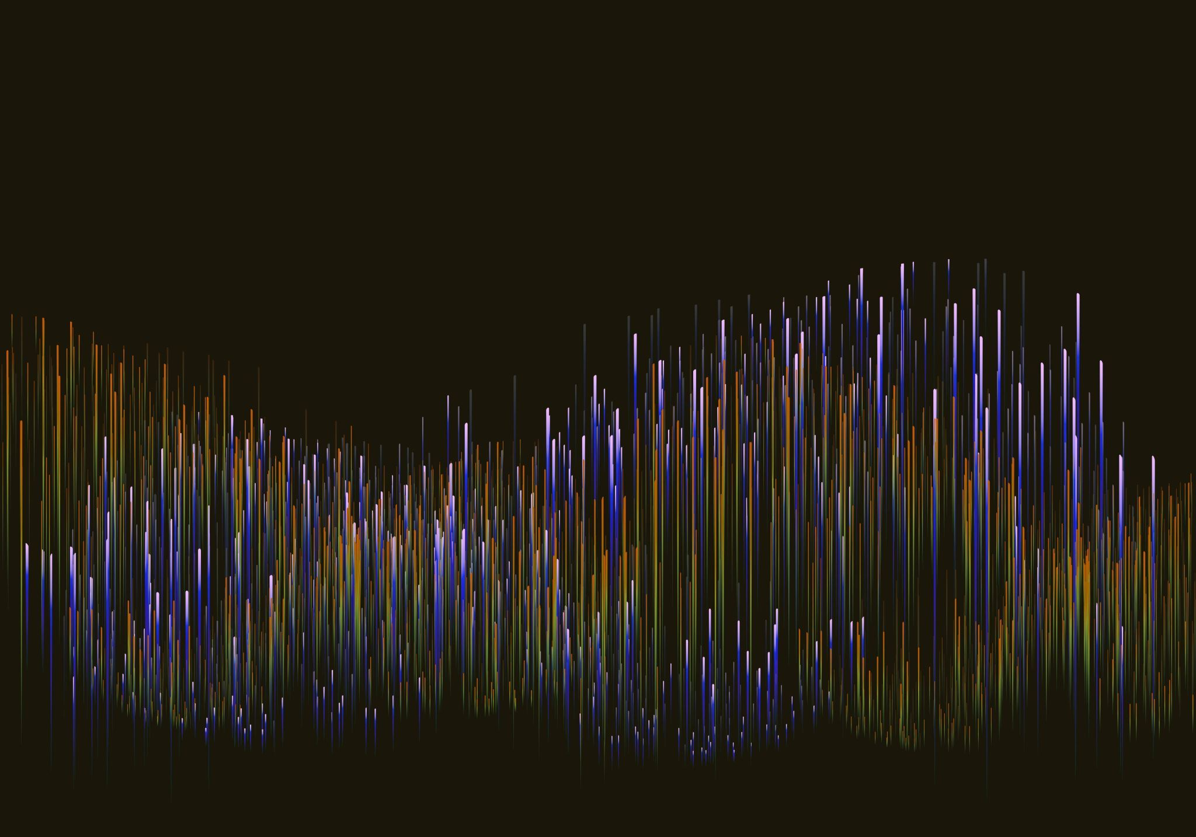
Breast Cancer Predictions
By: Hamda Hassan & Jennifer Poling

Slide 2
Agenda
Introduction
Data Analysis Process
Findings
Conclusion

Slide 3
Introduction
Dataset Overview
We worked with the Breast Cancer Wisconsin (Diagnostic) dataset, created by William H. Wolberg together with collaborators Nick Street and Olvi Mangasarian at the University of Wisconsin Hospitals.
The dataset consists of 30 different variables. These features (radius, concavity, concave points, etc.) describe characteristics of the cell nuclei of the mass.
Project Goals
Can we build a machine learning model to accurately predict whether a tumor is malignant or benign?
Which features are the strongest indicators of malignancy?
Notes:
(Hamda)

Slide 4
Data description
Breast Cancer Wisconsin data set
US Irvine Machine Learning Repository
Dr. William Wolberg collected samples and performed diagnosis
Dr. Nick Street and Dr. Olvi Mangasarian digitized and analyzed
Notes:
Dr. William H. Wolberg performed a breast cancer diagnosis on samples. The samples are fine needle aspirate of a mass collected from patients at the University of Wisconsin Hospitals.
Dr's Street and Mangasarian and their team extracted specific quantitative features from the digitized images of the cell nuclei.
QUALITY: Each data instance is confirmed by a clinical diagnosis (benign or malignant), providing a solid diagnosis label for training and testing models.
The collected breast mass samples were then digitized as images. Researchers in the University of Wisconsin Computer Sciences Department digitized and developed software to analyze these images.
The software extracted specific quantitative features from the digitized images of the cell nuclei. These features numerically describe various characteristics of the cells, such as radius, texture, perimeter, area, smoothness, and concavity.
Each data instance is confirmed by a clinical diagnosis (benign or malignant), providing a solid diagnosis label for training and testing models.

Slide 5
Data description
Breast Cancer Wisconsin data set
30 numeric feature columns
First 10 mean of characteristics
Second 10 standard deviation
Third 10 "worst"
1 diagnosis column (M, B)
569 instances

Slide 6
Data description
Breast Cancer Wisconsin data set
Informed consent
University of Wisconsin Hospitals study
Collected for diagnostic purposes
Waivers
Retrospective, anonymized, compliant with HIPAA
No personal information
Notes:
During that era, federal regulations (the "Common Rule") generally only required explicit informed consent for research if the specimens were linked to personal information and collected specifically for research purposes.
Subsequent studies that have used the dataset have often been granted waivers of informed consent by their own Institutional Review Boards (IRBs) because the data is retrospective, anonymized, and compliant with current privacy regulations like HIPAA.

Slide 7
Data Preparation
Checked for missing values
Verified that all 569 observations had complete data with no null entries.
Checked for invalid or negative values
Confirmed that all feature measurements (e.g., radius, area, concavity) were within valid biological ranges.
Considered multicollinearity between features
Many features (e.g., radius, perimeter, area) measure similar properties and are highly correlated.
We chose robust modeling approaches
Notes:
To ensure our dataset was clean and suitable for analysis, we completed the following steps
We checked for null and negative values in our dataset
To avoid multicollinearity issues, we were intentional about which features to include in our models and selected modeling approaches that are more robust to correlated predictors.

Slide 8
Analysis methods
Supervised learning
Single input logistic regression
Multiple input logistic regression
Random forest classification
XGBoost
Notes:
Hamda

Slide 9
Findings: Single input Model (Radius 1) logistic regression
Accuracy:
89.47% of the model's predictions matched the actual diagnosis
AUC (Area Under the ROC Curve)
94.97% of the time, the model gives a higher malignancy score to an actual malignant tumor than to a benign one.
Notes:
An AUC of 0.5 would mean the model is no better than random guessing; 1.0 would mean perfect ranking.
ROC curve: a plot of the true positive rate against the false positive rate.

Slide 10
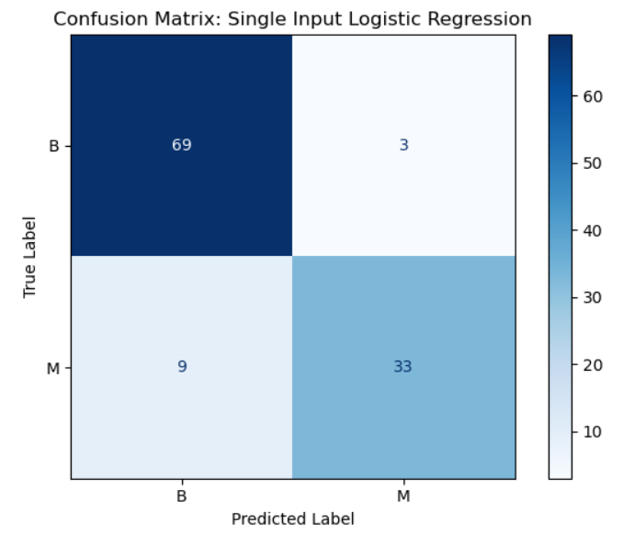
Findings: Single input model (radius 1) confusion matrix

Slide 11
Findings: Single input Model (concave points 1)
Accuracy: 0.6579
66% of the model's predictions matched the actual diagnosis
AUC: 0.9676
97% of the time the model correctly ranks a randomly chosen patient with the disease as higher risk than a randomly chosen patient without the disease
Notes:
Hamda

Slide 12
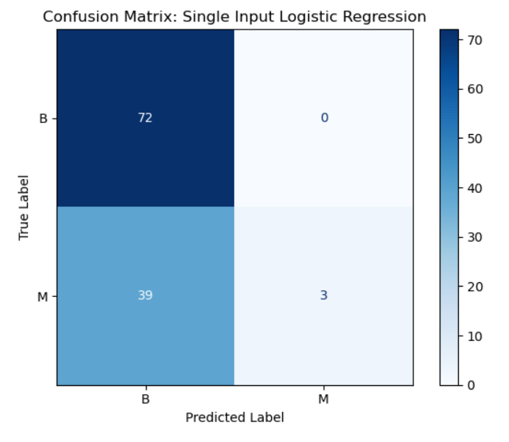
Findings: Single Model Input (concave points 1) confusion matrix
Notes:
Hamda

Slide 13
Multiple Input model: logistic regression
Accuracy:
95.61% of the model's predictions matched the actual diagnosis
statsmodels p-values: radius, texture, smoothness
multicollinearity: computed Variance Inflation Factors (VIFs)
Notes:
SCALED FEATURES train_test_split
All mean features except those derived from radius (perimeter, area, compactness)
P-values all 0, R-squared slightly lower but still strong

Slide 14
Findings: Multiple Input model logistic regression
Accuracy:
93.86% of the model's predictions matched the actual diagnosis
AUC (Area Under the ROC Curve)
93.15% of the time, the model gives a higher malignancy score to an actual malignant tumor than to a benign one.

Slide 15
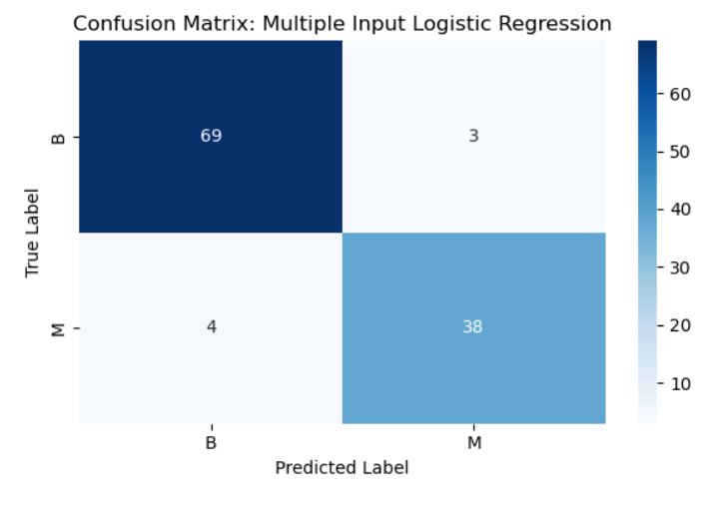
Findings: multiple Input model confusion matrix

Slide 16
Findings: random forest model
Accuracy: 0.9123
91% of the model's predictions matched the actual diagnosis
AUC: 0.9866
99% of the time the model correctly ranks a randomly chosen patient with the disease as higher risk than a randomly chosen patient without the disease
Notes:
Hamda

Slide 17
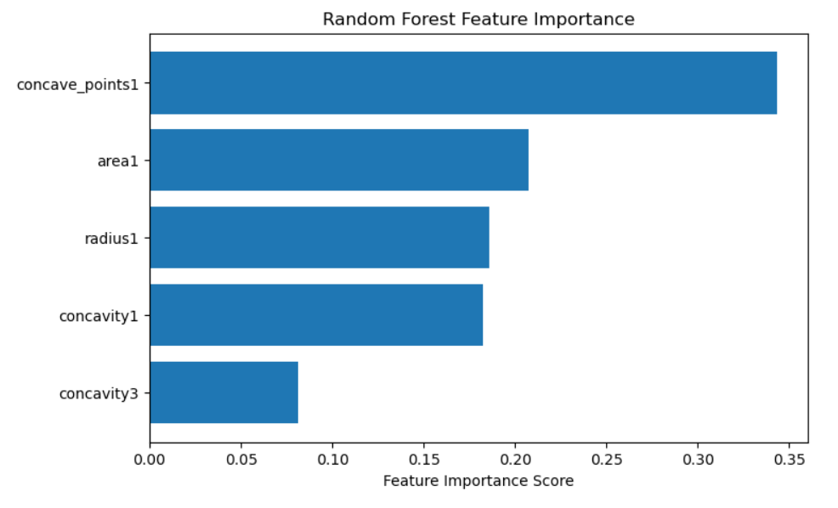
Notes:
Hamda

Slide 18
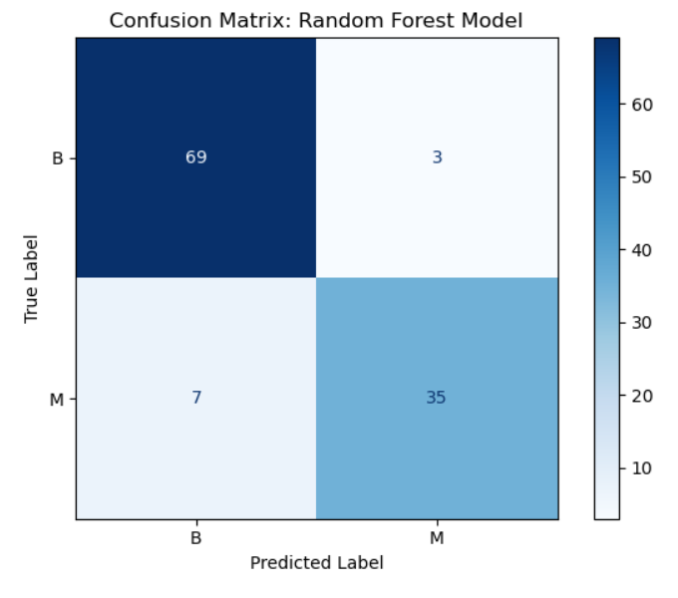
Findings: random forest model confusion matrix
Notes:
Hamda

Slide 19
xgboost model 1: all features
GridSearchCV to find best parameters
Accuracy:
98.25% of the model's predictions matched the actual diagnosis
Same or better accuracy with fewer features?

Slide 20
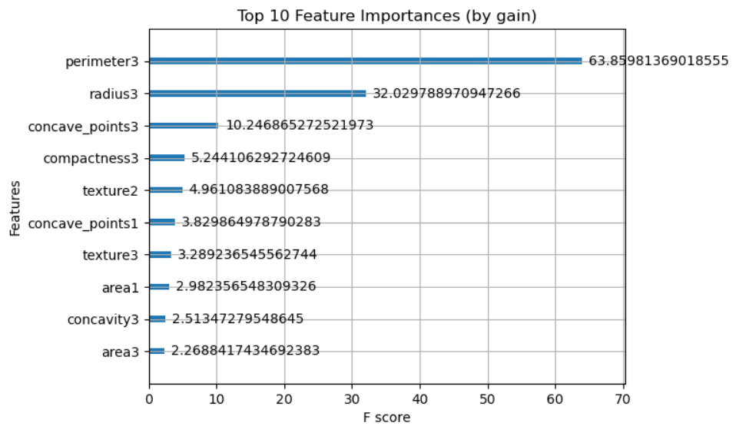

Slide 21
xgboost model 1: 10 features
Recursive Feature Elimination (RFE)
automatically test which subset of features gives the best accuracy
Accuracy:
94.74% of the model's predictions matched the actual diagnosis
Find optimal number of features

Slide 22
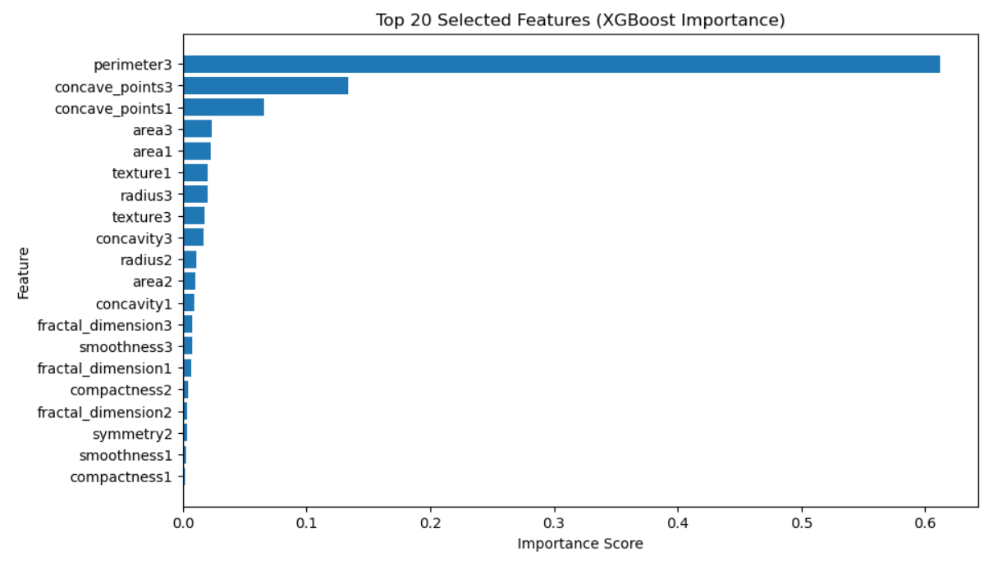

Slide 23
Findings: xgboost model
Accuracy:
99.12% of the model's predictions matched the actual diagnosis
AUC (Area Under the ROC Curve)
99.31% of the time, the model gives a higher malignancy score to an actual malignant tumor than to a benign one.

Slide 24
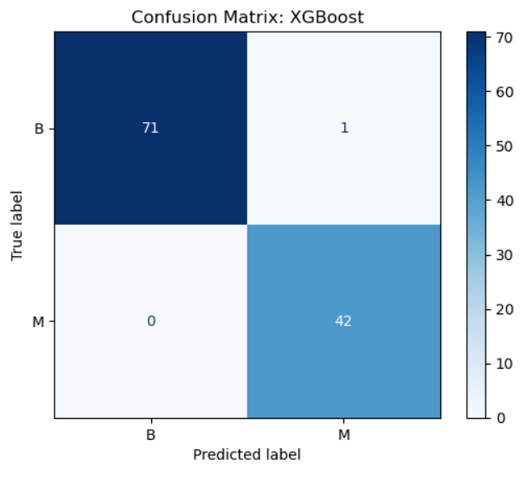
Findings: xgboost model confusion matrix

Slide 25
conclusion
Features predict cancer quite well
Best features varied by model
Best performance: XGBoost model
Notes:
Can we build a machine learning model to accurately predict whether a tumor is malignant or benign?
Which features are the strongest indicators of malignancy, and how well can they predict cancer?

Slide 26
Thank YOU!!!

